Slide 1
Cross-origin Resource Sharing
(CORS)

Slide 2
Notes
Most of the info, images, and examples in this slide are obtained from
HTTP access control (CORS) – MDN
https://developer.mozilla.org/en-US/docs/Web/HTTP/Access_control_CORS
"Ajax request" in the this note refers to a HTTP request made through XmlHttpRequest.

Slide 3
Introduction
Same origin => Same protocol, host, and port
  e.g., Only resources (1) and (2) have same origin
    http://www.example.com/dir/page1.html
    http://www.example.com/dir2/abc.jpg
    http://foo.example.com/dir/page2.html (different host)
    http://www.example.com:8000/index.html (different port)
    https://www.example.com/dir/page1.html (different protocol)
A resource makes a cross-origin HTTP request when it requests a resource from a different origin.
  e.g., An HTML page served from origin A embed an image from origin B or send an Ajax request to origin B.
For security reasons, browsers by default restrict cross-origin HTTP requests initiated from within scripts. (e.g., Ajax)

Slide 4
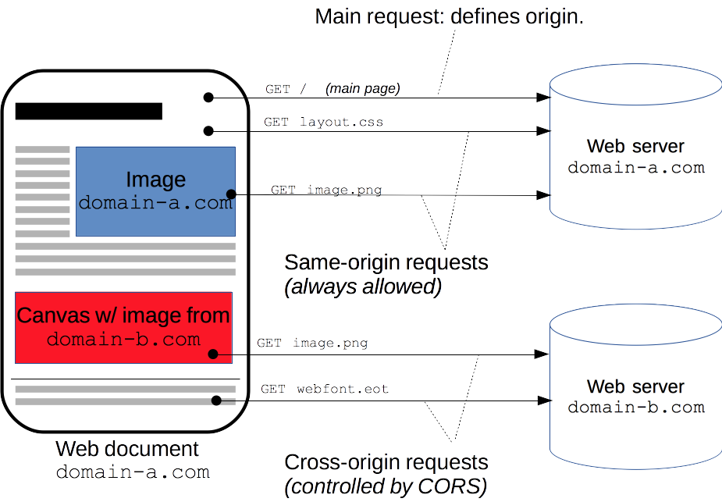
Introduction
Notes:
Image source: "HTTP access control (CORS)" -- Mozilla Developer Network
https://developer.mozilla.org/en-US/docs/Web/HTTP/Access_control_CORS

Slide 5
Overview of CORS Standards
The CORS standard describes how a client and a server should interact to make CORS request possible without compromising security.
The standard adds new HTTP headers that allow servers to inform clients
  Which origins are permitted to send CORS request
  What headers are permitted in the request
  What HTTP request methods are permitted
  Whether "credentials" (including Cookies and HTTP Authentication data) should be sent with requests
The standard also describes how clients should "preflight" certain requests before sending the actual request.
Notes:
CORS protocol: https://fetch.spec.whatwg.org/#http-cors-protocol

Slide 6
Scenarios that involves CORS
Simple CORS requests
Preflighted CORS requests
Note: These two scenarios are used by "HTTP access control (CORS) – MDN" to illustrate how CORS work.

Slide 7
Simple CORS Request
Does not trigger a CORS preflight
Must meet all of the following conditions:
  Method is one of GET, POST, HEAD
  Only certain "standard" headers (e.g., Connection, User-Agent, Accept-*, Content-Type) are allowed.
  Content-Type is one of
    application/x-www-form-urlencoded
    multipart/form-data
    text/plain

Slide 8
Simple CORS Request (Example)
Scenario: A script in a page from http://foo.example sends an Ajax request (GET method) to http://bar.other/...
GET /resources/public-data/ HTTP/1.1
Host: bar.other
…
Origin: http://foo.example
First, the client sends a HTTP request by the GET method to bar.other with an "Origin" header to indicate the origin of the page that initiated the request.

Slide 9
Simple CORS Request (Example)
HTTP/1.1 200 OK
…
Access-Control-Allow-Origin: *
Content-Type: application/xml
[XML Data]
If the server accepts the request from the indicated origin, it will add a "Access-Control-Allow-Origin" header in the response.
The value of this header field can be as specific as http://foo.example
or as a wildcard, * (to represent all origins).
Without a properly set "Access-Control-Allow-Origin" header, the client will still receive a full response but it will not pass the response to the script on the page.

Slide 10
Preflighted CORS Request
Involves two requests
  1st request (preflight): The client sends a HTTP request (OPTIONS method) to the other domain to ask for "permissions".
  2nd request: If the permissions requested in the 1st request are granted by the server, the client sends the actual HTTP request (as if it is a simple CORS request).
A CORS request is preflighted if it does not satisfy the conditions of a "Simple CORS request"

Slide 11
Preflighted CORS Request
Scenario: A script in a page from http://foo.example sends an Ajax request to http://bar.other/ with the following characteristics
POST method
A non-standard header "X-PINGOTHER"
Content-type set to "text/xml"

Slide 12
Preflighted CORS Request (Example)
OPTIONS /resources/post-here/ HTTP/1.1
Host: bar.other
…
Origin: http://foo.example
Access-Control-Request-Method: POST
Access-Control-Request-Headers: X-PINGOTHER, Content-Type
In the first request, the client sends a HTTP request (OPTION method) to bar.other to ask for permissions.
HTTP/1.1 200 OK
…
Access-Control-Allow-Origin: http://foo.example
Access-Control-Allow-Methods: POST, GET, OPTIONS
Access-Control-Allow-Headers: X-PINGOTHER, Content-Type
The server responds with various header fields to indicate what permissions are granted to the client.

Slide 13
Preflighted CORS Request (Example)
POST /resources/post-here/ HTTP/1.1
Host: bar.other
…
X-PINGOTHER: pingpong
Content-Type: text/xml; charset=UTF-8
Content-Length: 55
Origin: http://foo.example
<?xml version="1.0"?><person><name>Arun</name></person>
In the second request, the client sends the actual HTTP request like it is a simple CORS request.
HTTP/1.1 200 OK
…
Access-Control-Allow-Origin: http://foo.example
…
The server responds normally. Just like a simple CORS request, the server will include a "Access-Control-Allow-Origin" header (or else client will not pass the response to the script).

Slide 14
Further Readings and References
HTTP access control (CORS) – MDN
  https://developer.mozilla.org/en-US/docs/Web/HTTP/Access_control_CORS
Server-Side Access Control (CORS) – MDN (with PHP examples)
  https://developer.mozilla.org/en-US/docs/Web/HTTP/Server-Side_Access_Control

